Slide 1
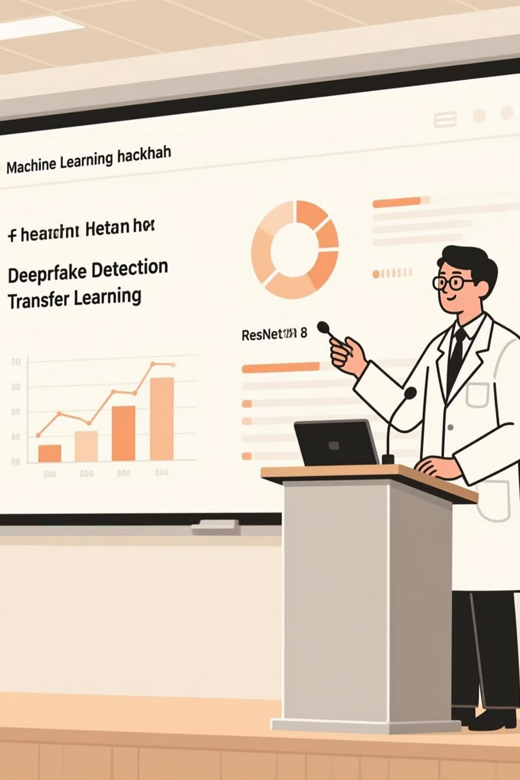
Deepfake Detection Using Transfer Learning (ResNet18)
Synergy’25 Deepfake ML Model Hackathon
Team: ShashankPadmasale
Team Leader : Shashank
Tagline: “Building trust in digital media through intelligent deepfake detection”
By Shashank

Slide 2

The Deepfake Challenge
AI-generated content (deepfakes) threatens media trust and authenticity.
Detecting fake images is critical for digital security and social awareness.
Goal: Develop an ML model to predict whether an image is real or fake, mimicking a proprietary deepfake detector.
By Shashank

Slide 3
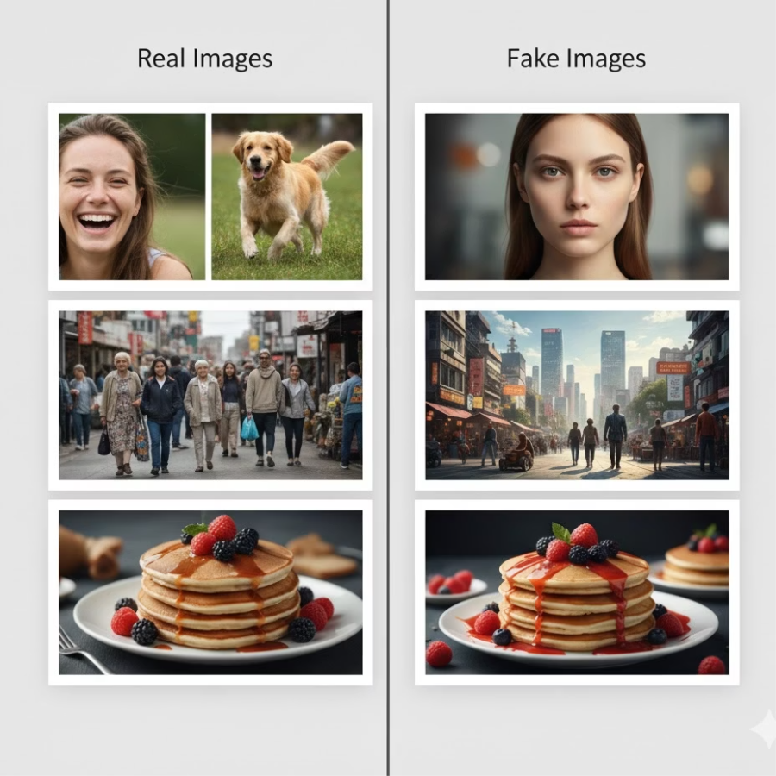
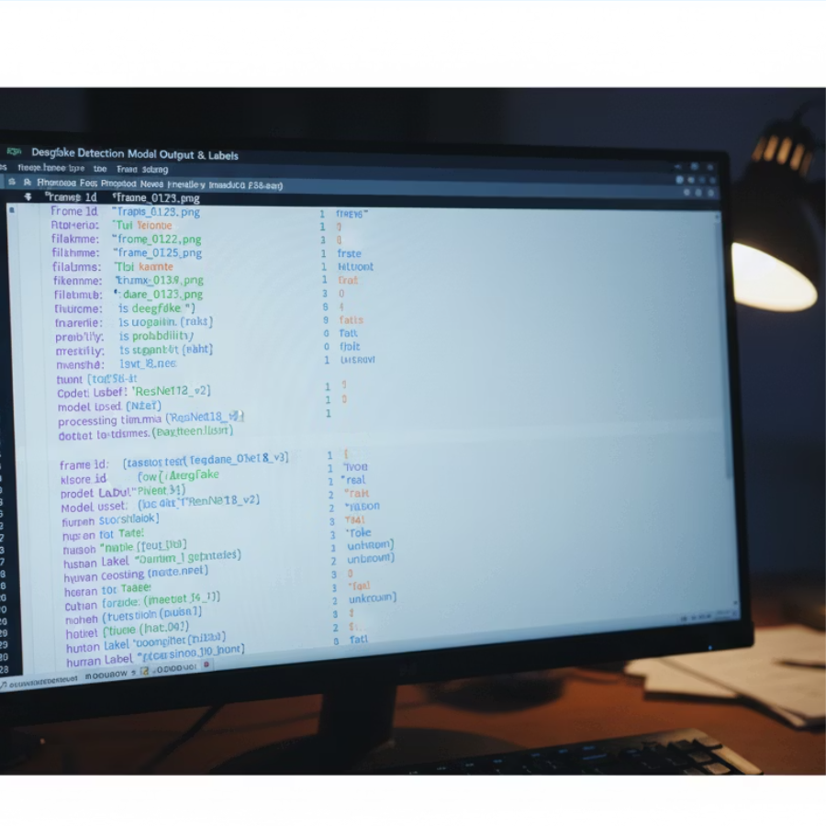
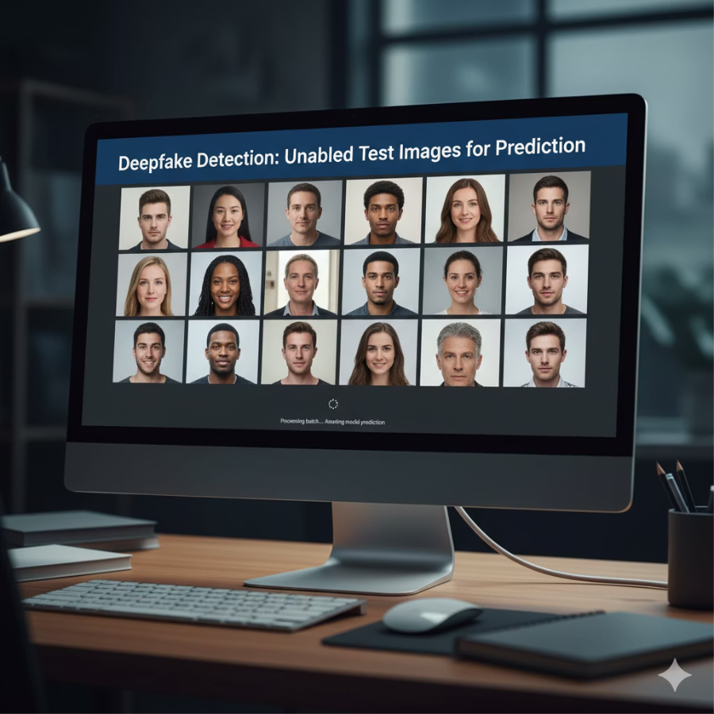
Dataset Summary
The dataset provided the foundation for training the deepfake detection model.
Training Data
Proprietary Labels
Test Data
2000 training images (1000 real + 1000 fake)
A JSON file with proprietary model outputs
Unlabeled test images for final prediction
Key Task: Learn correlations between image features and detection outputs.
By Shashank

Slide 4





End-to-End Pipeline
Data Prep
Model Train
Resize and normalize images
Fine-tune final layers for binary
Feature Extract
Evaluation
Use pretrained ResNet18 features
Compute accuracy and loss curves
01
02
03
Data Preprocessing
Feature Extraction
Model Training
Resize & normalize images
Use pretrained ResNet18 on ImageNet
Fine-tune final layers for binary classification
04
05
Evaluation
Inference
Compute accuracy and loss curves
Generate predictions for test set → JSON format
By Shashank

Slide 5

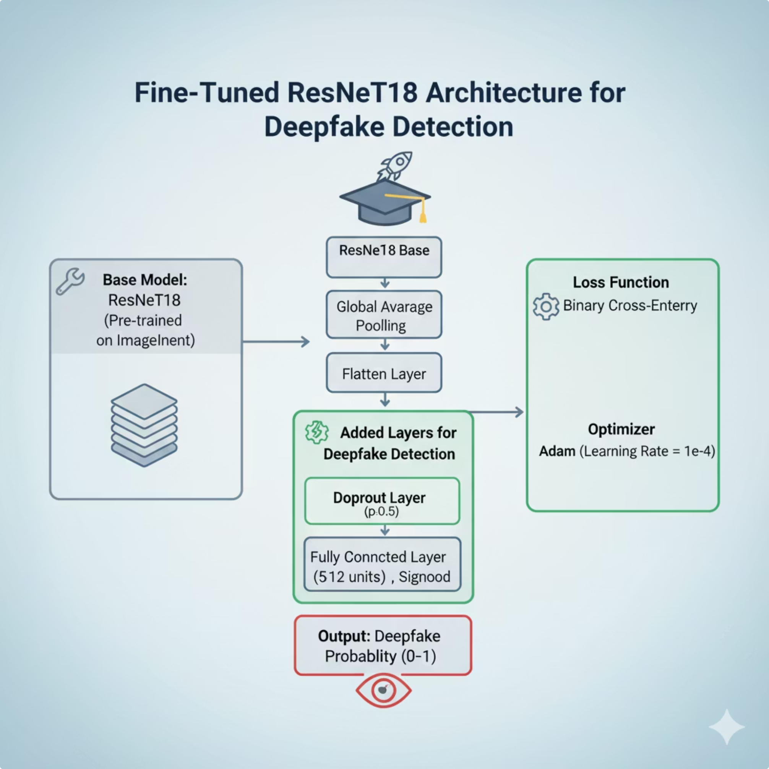
Model Overview (ResNet18 Fine-Tuning)
The model leverages transfer learning to efficiently detect deepfakes.
Architecture Details
Base model: ResNet18 (transfer learning from ImageNet)
Added layers:
Flatten → Linear(512 → 128) → ReLU → Dropout(0.3)
Linear(128 → 1) → Sigmoid
Loss: Binary Cross Entropy (BCE)
Optimizer: Adam (lr=0.001, batch=32, epochs=5)
By Shashank

Slide 6
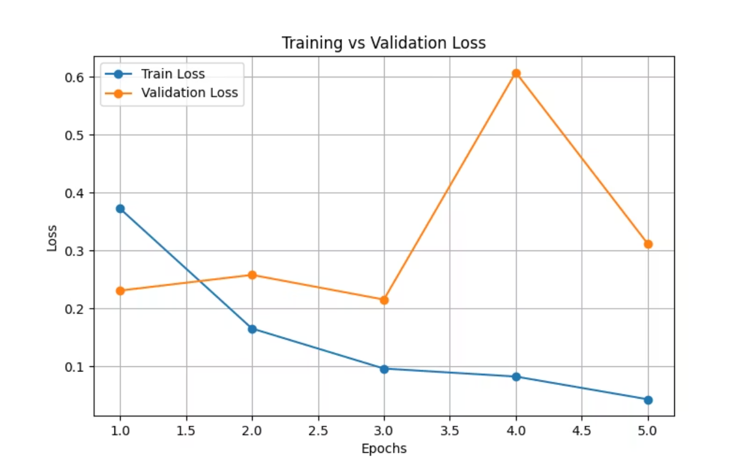
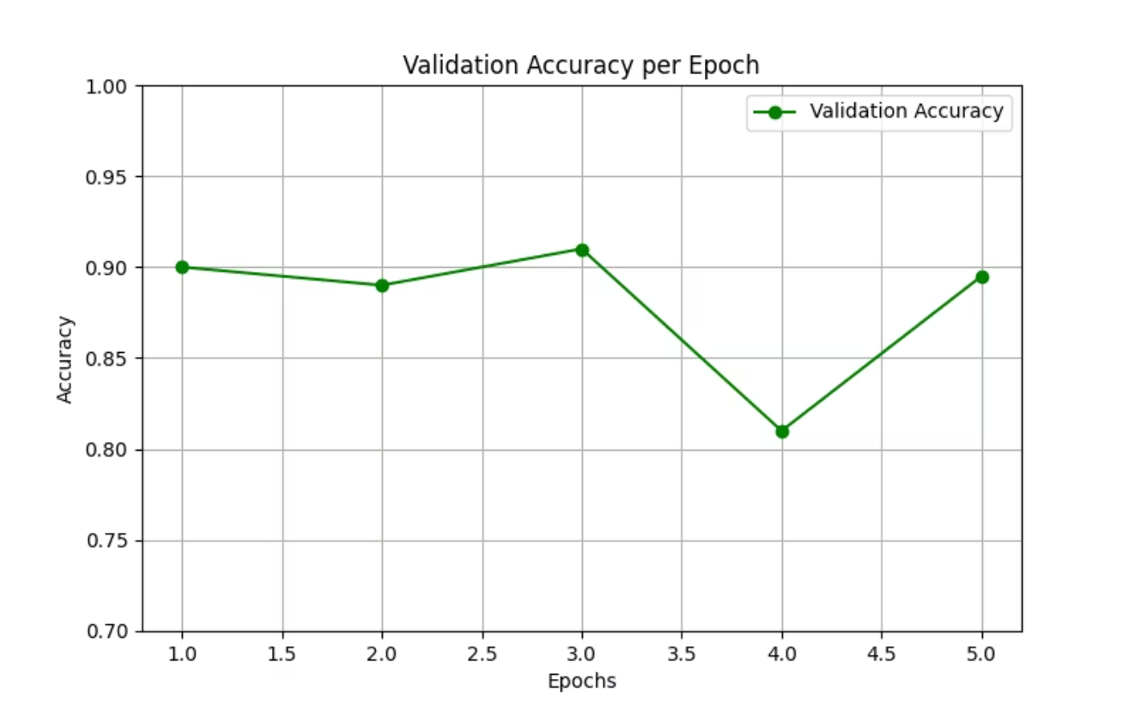
Model Performance
Training vs Validation Loss (loss_curve.png)
Validation Accuracy per Epoch (accuracy_curve.png)
~90%
0.23
5
Validation Accuracy
Validation Loss
Epochs Trained
Observation: Stable convergence with minimal overfitting.
By Shashank

Slide 7




Tech Stack
Category
Tools Used
Programming
Python
Framework
PyTorch, Torchvision
Data Handling
JSON, Pandas, NumPy
Visualization
Matplotlib
Environment
Windows 11
Hardware
CPU (Intel i7) + optional RTX 3050 GPU
By Shashank

Slide 8

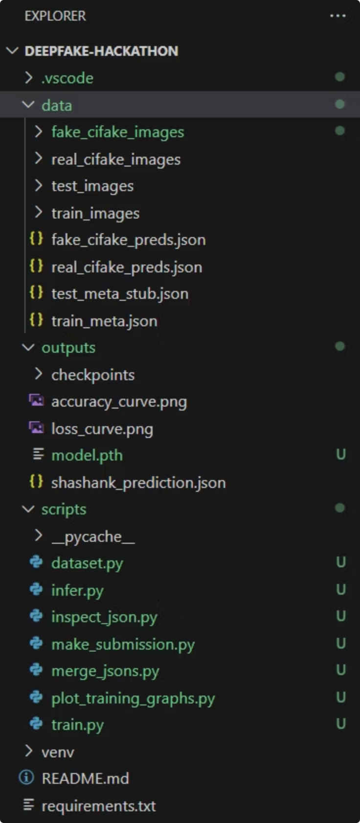
Final Output
Example JSON:
[ {"image\_id": "1.png", "prediction": 0.00025}, {"image\_id": "10.png", "prediction": 0.99988} ]
Deliverables:
shashank_prediction.json
README.md
make_submissions.py (auto-zips submission)
By Shashank

Slide 9

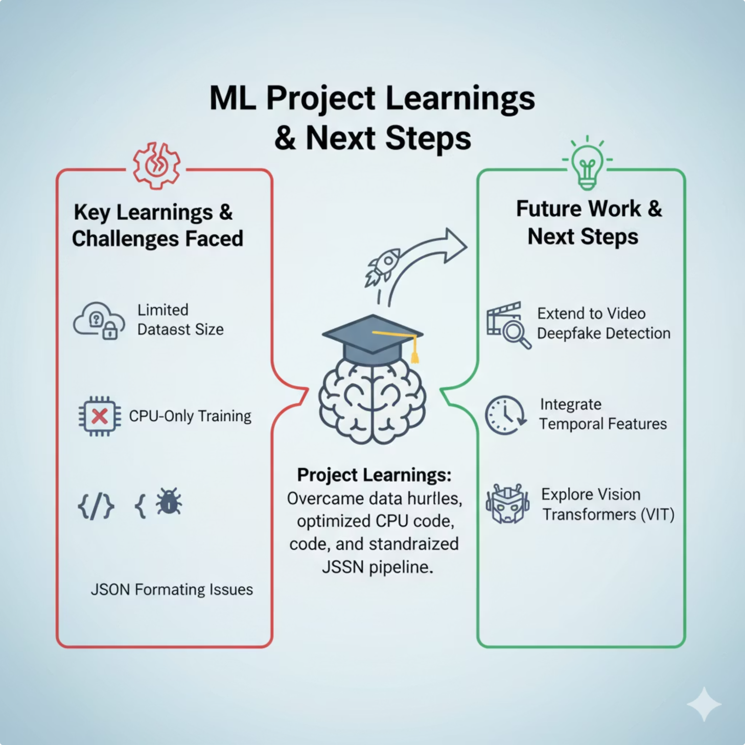
Key Learnings & Next Steps
Challenges Faced
Future Work
Limited dataset size (solved with transfer learning)
Extend to video deepfake detection
CPU-only training (optimized epochs & transforms)
Integrate temporal features
Explore Vision Transformers (ViT) for improved accuracy
JSON formatting issues (handled via validation script)
By Shashank

Slide 10

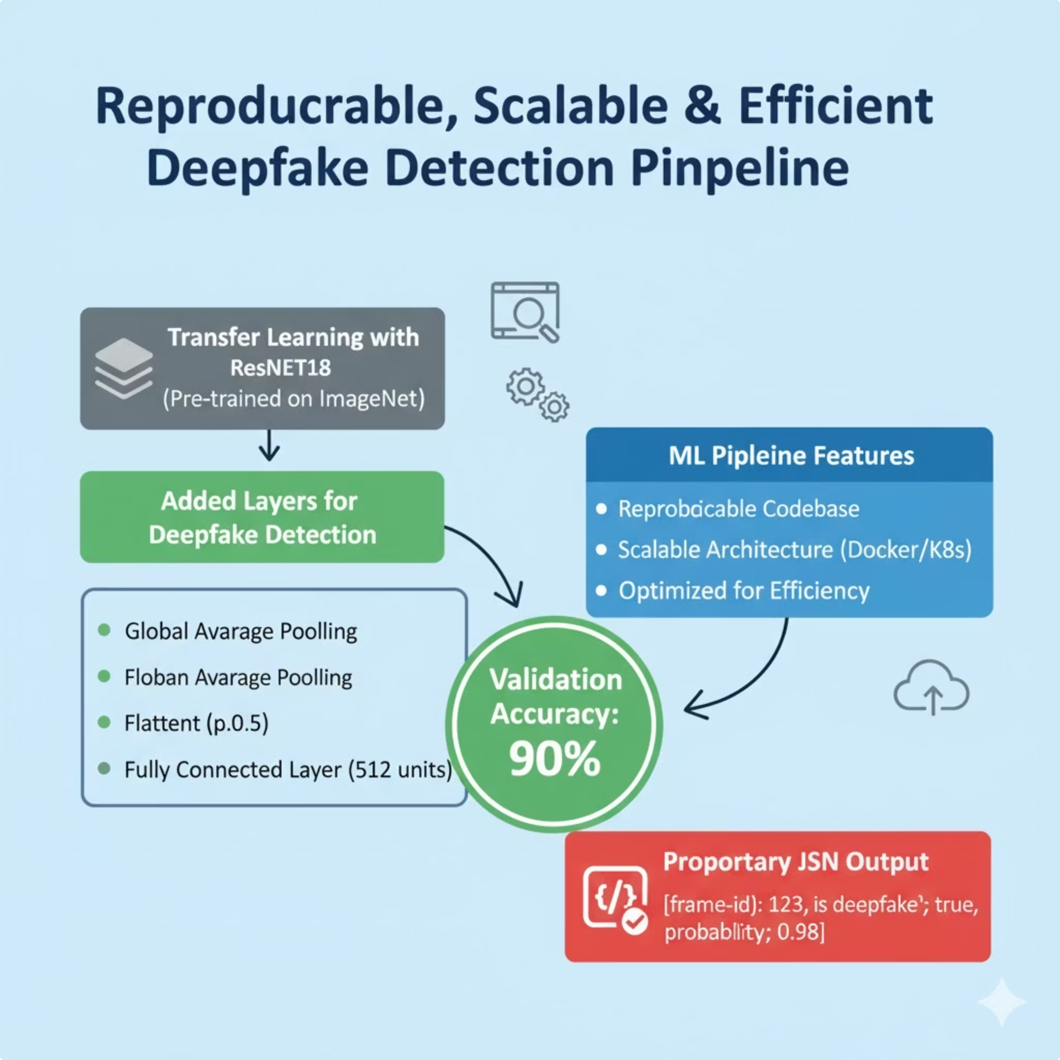
Final Summary
Built a transfer learning-based deepfake detector using ResNet18.
Achieved 90% accuracy on validation data.
Delivered a reproducible, scalable, and efficient ML pipeline.
All outputs formatted to proprietary JSON style.
“The fight against deepfakes begins with intelligent AI — not fear.”
Footer: Shashank Padmasale — Synergy’25 Hackathon Participant
By Shashank

